Slide 1

Introduction to Flask
SoftUni Team
Technical Trainers
Software University
https://softuni.bg

Slide 2
Table of Contents
What is Flask
Template vs REST apps
HTTP Basics
Request - Response
Flask RESTful
One-file app demo
2

Slide 3
Have a Question?
sli.do
#Flask

Slide 4

What is Flask?

Slide 5
FLASK
Flask is Python’s micro-framework for web app development
Werkzeug WSGI toolkit
Jinja2 template engine
Ease of setup, learn and use
Freedom to build the structure of the web application
5

Slide 6
Install Python and Flask
Python >= 3.6
python –-version
python -m venv {your_abs_path}
pip install Flask
6

Slide 7
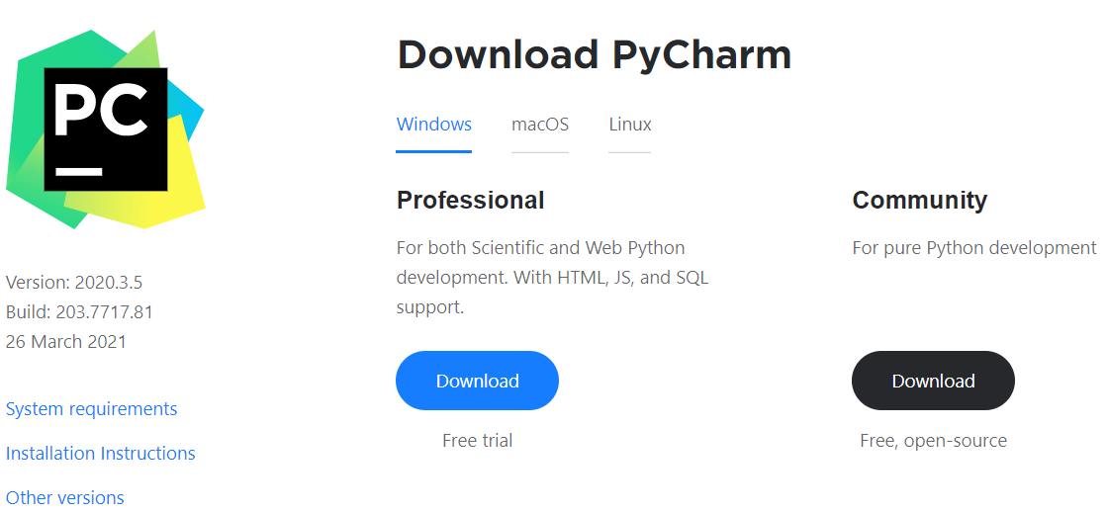
Write Python in IDE
You can also code in Python using IDE (for example: PyCharm)
You can download PyCharm from here: https://www.jetbrains.com/pycharm/download
7

Slide 8

Template vs REST
Jinja 2, FlaskRESTful

Slide 9
SSR pros (server-side rendering)
SEO friendly –pages are easily indexable by search engines
Better performance for the user – User will see the content faster
User-machine is less busy
Best for static sites
9

Slide 10
SSR cons
TTFB (Time to first byte) is slower
The server will be busier, can execute fewer request per second
HTML doc will be bigger
Full page reload after routes change (request the page each time)
10

Slide 11
CSR pros (client-side rendering)
Fast render after initial load
Faster navigation
Lower server load
Remarkable for web apps
11

Slide 12
CSR cons
Slower initial load
Client-side routing solutions can delay web crawling
SEO – if you not implemented correctly
Initial req loads the page, CSS, layout, js
Some or all content is not included
12

Slide 13
REST
REST API is easy to understand and learn, due to its simplicity, known API.
REST API is easy to explore and discover
It makes it simple for new clients to work on other applications, whether it is designed specifically for purpose or not
13

Slide 14

What is URL

Slide 15
What are URL's
A Uniform Resource Locator (URL) is a reference to a web resource that specifies its location on a network and a mechanism for retrieving it
A URL is a specific type of URI (Uniform Resource Identifier) although many people use the two terms interchangeably

Slide 16
URL Structure
protocol
root domain
subdirectory
https://www.example.com/blog/page-name
sub domain
top level domain
file name

Slide 17

Templates
Generate HTML Dynamically

Slide 18
What is a Template
Being a web framework, Flask needs a convenient way to generate HTML dynamically
The most common approach relies on templates
A template contains the static parts of the desired HTML output as well as some special syntax describing how dynamic content will be inserted

Slide 19
Example
main.py (in the app)
index.html
from flask import Flask, render_template
app = Flask(__name__)
@app.route("/")
def hello():
context = {"name": "Flask"}
return render_template("index.html", **context)
<!DOCTYPE html>
<html lang="en">
<head>
<meta charset="UTF-8">
<title>Title</title>
</head>
<body>
<h1 style="color:green">Hello, {{ name }} !</h1>
</body>
</html>

Slide 20
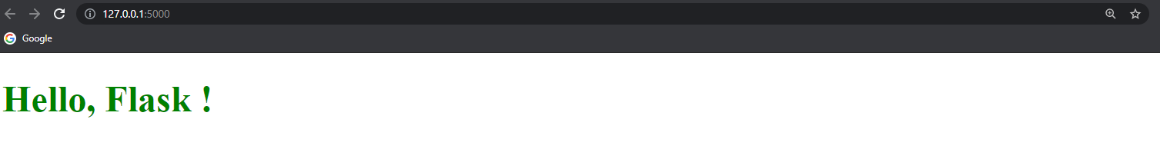
Result

Slide 21
Web Communication Explained
http://
HTTP Basics

Slide 22



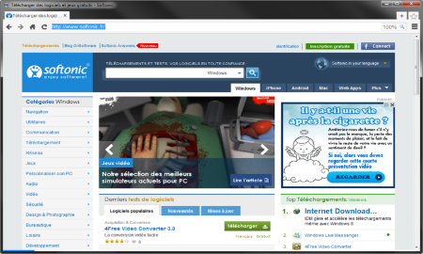





Web Server Work Model
Web Client
Web Server
Technology
Request
Response
Web Resources
Database
HTML, PDF, JPG…

Slide 23
Web Server Work Model (2)
Web Client
Web Server
Technology
Request
Flask
Response
Web Resources
Database
HTML, PDF, JPG…

Slide 24


Hyper Text Transfer Protocol
Request
Response
HTTP
HTTP
TCP
TCP
IP
IP
Ethernet
Media (wires / air / fiber)
Ethernet
Notes:
HTTP == Hyper Text Transfer Protocol
Client-server protocol for transferring Web resources (HTML files, images, styles, scripts, data, etc.)
The widespread protocol for Internet communication today
Request-response model (client requests, server answers)
Text-based format (human readable)
Relies on unique resource URLs
Provides resource metadata (e.g. encoding)
Stateless (cookies and Web storages can overcome this)

Slide 25
HTTP Request Methods
Method | Description
POST | Create / store a resource
GET | Read / retrieve a resource
PUT | Update / modify a resource
DELETE | Delete / remove a resource
Other HTTP Methods
CONNECT
HEAD
OPTIONS
TRACE
The four basic functions of persistence storage.

Slide 26
HTTP Conversation: Example
GET /courses/javascript HTTP/1.1
Host: www.softuni.bg
User-Agent: Mozilla/5.0
<CRLF>
HTTP request:
HTTP response:
The empty line denotes the end of the request headers
HTTP/1.1 200 OK
Date: Mon, 5 Jul 2010 13:09:03 GMT
Server: Microsoft-HTTPAPI/2.0
Last-Modified: Mon, 12 Jul 2014 15:33:23 GMT
Content-Length: 54
<CRLF>
<html><title>Hello</title>
Welcome to our site</html>
The empty line denotes the end of the response headers

Slide 27

Tools for Developers
Dev Tools

Slide 28
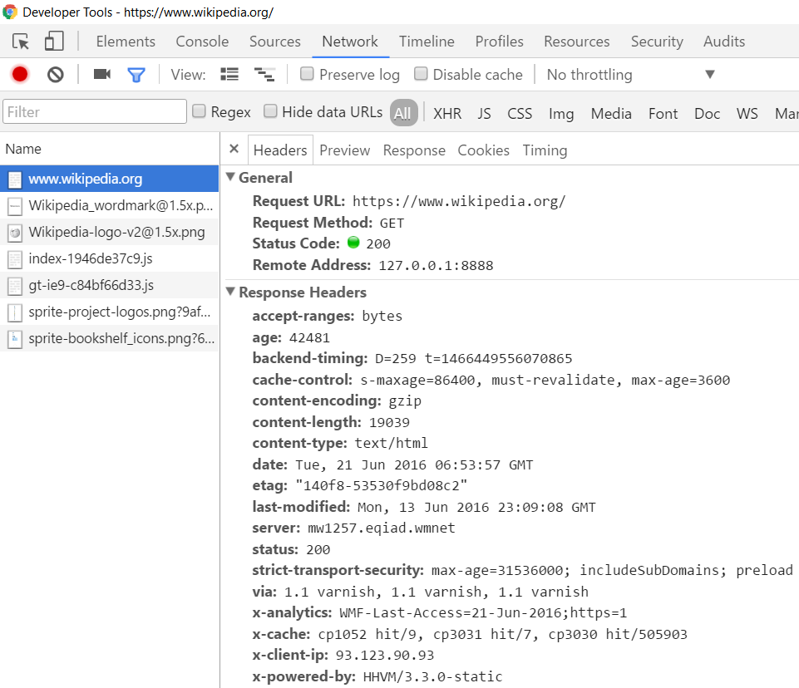
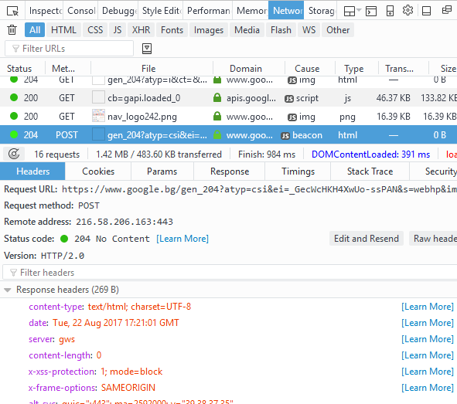
Tools for Developers – Browser Dev Tools
Chrome Developer Tools
Mozilla Developer Tools

Slide 29

Tools for Developers – Browser Add-ons
</>
Postman - Chrome
Rested - Firefox

Slide 30
What is a HTTP Request?
HTTP Request

Slide 31
HTTP Request Message
Request message sent by a client consists of:
HTTP request line
Request method (GET / POST / PUT / DELETE / …)
Resource URI (URL)
Protocol version
HTTP request headers
Additional parameters
HTTP request body – optional data e.g., posted form fields
<method> <resource> HTTP/<version>
<headers>
(empty line)
<body>

Slide 32
GET Request Method – Example
<form method="get">
Name: <input type="text" name="name" />
Age: <input type="text" name="age" />
<input type="submit" />
</form>
HTTP request line
GET /HTTP/1.1
Host: localhost
<CRLF>
HTTP request headers
The request body is empty

Slide 33
POST Request Method – Example
The POST method transfers data in the HTTP body
POST can send text and binary data e.g., upload files
HTTP request line
POST /login HTTP/1.1
Host: localhost
Content-Length: 59
<CRLF>
username=mente&password=top*secret!
<CRLF>
HTTP request headers
The request body holds the submitted form data

Slide 34

What is a HTTP Response?
HTTP Response

Slide 35
HTTP Response Message
The response message sent by the HTTP server consists of:
HTTP response status line
Protocol version
Status code
Status text
Response headers
Provide meta data about the returned resource
Response body
The content of the HTTP response (data)
HTTP/<version> <status code> <status text>
<headers>
<CRLF>
<response body – the requested resource>

Slide 36
HTTP Response – Example
Example of HTTP response from the Web server:
HTTP response status line
HTTP/1.1 200 OK
Date: Fri, 17 Jul 2010 16:09:18 GMT+2
Server: Apache/2.2.14 (Linux)
Accept-Ranges: bytes
Content-Length: 84
Content-Type: text/html
<CRLF>
<html>
<head><title>Test</title></head>
<body>Test HTML page.</body>
</html>
HTTP response headers
HTTP response body

Slide 37
HTTP Response Codes
HTTP response code classes
1xx: informational (e.g., "100 Continue")
2xx: successful (e.g., "200 OK", "201 Created")
3xx: redirection (e.g., "304 Not Modified", "301 Moved Permanently", "302 Found")
4xx: client error (e.g., "400 Bad Request", "404 Not Found", "401 Unauthorized", "409 Conflict")
5xx: server error (e.g., "500 Internal Server Error", "503 Service Unavailable")

Slide 38
HTTP Response – Example
Example of HTTP response with error result:
HTTP response status line
HTTP/1.1 404 Not Found
Date: Fri, 17 Nov 2014 16:09:18 GMT+2
Server: Apache/2.2.14 (Linux)
Connection: close
Content-Type: text/html
<CRLF>
<HTML><HEAD><TITLE>404 Not Found</TITLE></HEAD>
<BODY>
<H1>Not Found</H1>
The requested URL /img/logo.gif was not found on this server.<P> <HR><ADDRESS>Apache/2.2.14 Server at Port 80</ADDRESS>
</BODY></HTML>
HTTP response headers
The HTTP
response body

Slide 39
Browser Redirection
HTTP GET requesting a moved URL:
The following HTTP response (301 Moved Permanently) tells the browser to request another URL:
GET / HTTP/1.1
Host: http://softuni.org
User-Agent: Gecko/20100115 Firefox/3.6
<CRLF>
HTTP/1.1 301 Moved Permanently
Location: http://softuni.bg
...

Slide 40
Content-Type and Disposition
With Content-Type response header the server specifies how the output should be processed
Examples:
UTF-8 encoded HTML page. Will be shown in the browser.
Content-Type: text/html; charset=utf-8
Content-Type: application/pdf
Content-Disposition: attachment; filename="Report-April-2016.pdf"
This will download a PDF file named Report-April-2016.pdf

Slide 41
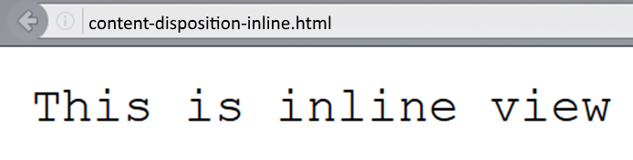
Content-Disposition – Example
Content-Type: text/plain
Content-Length: 19
Content-Disposition: inline filename=example.txt

Slide 42
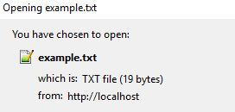
Content-Disposition – Example (2)
Content-Type: text/plain
Content-Length: 19
Content-Disposition: attachment; filename=example.txt

Slide 43
Flask-RESTful
FLASK RESTful
Definition and Usage

Slide 44
What is Flask-RESTful?
Flask-RESTful is an extension for Flask that adds support for quickly building REST APIsAPI
is Application Programming Interface
defines how other components/systems can use it
defines the kinds of calls or requests that can be made
can provide extension mechanisms for extending existing functionalities

Slide 45
Why use REST?
The reasons you might want to use Flask-RESTful are
It is a lightweight abstraction that works with your existing ORM/libraries
Encourages best practices with minimal setupSerialization that supports both ORM and non-ORM data sources
If you are familiar with Flask, Flask-RESTful should be easy to pick up

Slide 46
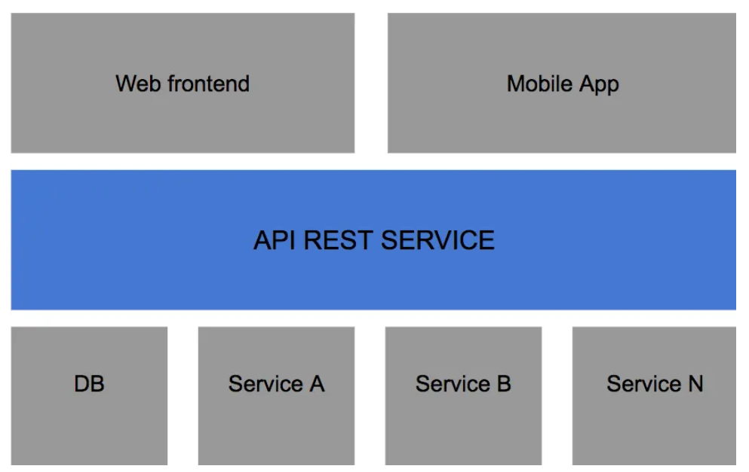
Flask-RESTful APIs
Flask-RESTful lets you create RESTful APIs - a way to transfer information between an interface and a database in a simple way

Slide 47
RESTful Structure
In a RESTful API, endpoints (URLs) define the structure of the API and how users access using the HTTP methods
GET, POST, PUT, DELETE
Endpoint | GET | POST | PUT | DELETE
/books/ | Show all books | Add new book | Update all books | Delete all books
/books/<id> | Show <id> | N/A | Update <id> | Delete <id>

Slide 48
Example with in-memory DB
class Books(Resource):
def get(self):
return {"data": [b.serialize() for b in books]}
def post(self):
try:
data = request.get_json()
book = BookModel(**data)
books.append(book)
return book.serialize(), 201
except Exception as ex:
return {"error": "Bad Request"}, 400

Slide 49

Live Exercises

Slide 50
Questions?
Notes:
50

Slide 51












SoftUni Diamond Partners

Slide 52


Educational Partners

Slide 53

License
This course (slides, examples, demos, exercises, homework, documents, videos and other assets) is copyrighted content
Unauthorized copy, reproduction or use is illegal
© SoftUni – https://about.softuni.bg
© Software University – https://softuni.bg
Notes:
53

Slide 54
Trainings @ Software University (SoftUni)
Software University – High-Quality Education, Profession and Job for Software Developers
softuni.bg, softuni.org
Software University Foundation
softuni.foundation
Software University @ Facebook
facebook.com/SoftwareUniversity
Software University Forums
forum.softuni.bg
Notes:
54

